Slide 1
Solving Sudoku with Backtracking and MRV Heuristic
OOPS USING C++ PROJECT PRESENTATION

Slide 2
CONTENTS
Introduction
Solving with Recursion
Dis-advantages of using traditional recursion
Introducing MRV Heuristics
Summary

Slide 3
INTRODUCTION
The problem of solving a Sudoku puzzle is a classic example of constraint satisfaction.
We aim to fill a 9x9 grid such that every row, every column, and every 3x3 sub grid contains the digits 1 through 9, without repetition.
In this code, we utilize the backtracking technique along with the Minimum Remaining Values (MRV) heuristic to efficiently solve the puzzle.

Slide 4
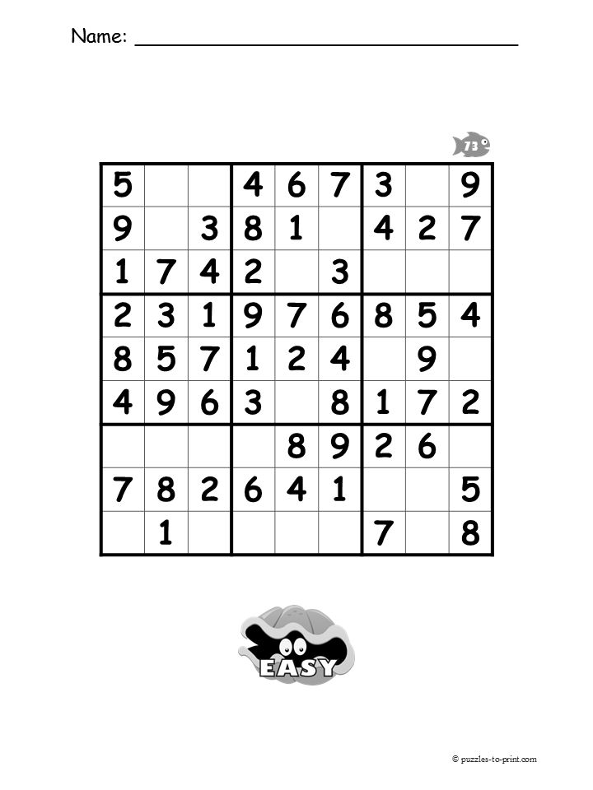
SUDOKU PROBLEM

Slide 5
WHAT IF WE SOLVE CENTER GRID FIRST?
THEN 2 SOLUTIONS FOR 5TH ROW IS ONLY 3,9
AS 2ND SUB-GRID HAS ALREADY 3 SO EMPTY CELL IN 2ND SUB-GRID SHOULD ONLY HAVE 9
WHICH MEANS ONLY SOLUTION FOR EMPTY CELL IN POSITION (9,5) IS 3
SIMILARLY WE CAN SOLVE OTHER CELLS WITH LESS POSSIBILITES THAN PREVIOUS APPROACH
THIS APPROACH OF SELECTING A CELL WITH MINIMUM POSSIBILITES FIRST, WHICH SIGNIFICANTLY REDUCES TOTAL NUMBER OF POSSIBILITIES TO BE CALCULATED IS POPULARLY KNOWN AS MINIMUM REMAINING VALUES (MRV) HEURISTIC.

Slide 6
APPROACH OF SOLVING SUDOKU IN CODE
FROM THE ENTIRE BOARD, WE FIRST PICK A CELL WITH LEAST VALID
SOLUTIONS.
WE THEN PLACE A VALID VALUE IN THAT CELL, AND THEN MAKE FURTHER SOLVING OF THAT BOARD.
THEN AGAIN PUT EMPTY CELL USING ZERO AND TRY ANOTHER VALID VALUE IN THAT CELL.
SO THAT TRY ALL VALID SOLUTIONS IN A CELL
SIMILARLY TRY ALL EMPTY CELLS

Slide 7
USAGE OF OOPS CONCEPTS IN THE CODE
1. Encapsulation:
Encapsulation is achieved by organizing the logic of the Sudoku solver within a class (Sudoku Solver). The class encapsulates:
Private data members:
board: The current state of the Sudoku grid.
Original Board: The initial state of the Sudoku grid for display purposes.
Private methods:
Is Valid: Checks if placing a number in a specific cell is valid.
Find MRV Cell: Implements the Minimum Remaining Values (MRV) heuristic to find the cell with the fewest options.
solve: A recursive backtracking method to solve the Sudoku puzzle.
Public access is provided through controlled methods like solve And Display and display.

Slide 8
2. Abstraction:
The complexity of the Sudoku solving algorithm (e.g., checking cell validity, MRV heuristic, and recursion) is abstracted away within the class. From the user's perspective, they only need to interact with:
The constructor Sudoku Solver to provide the initial board.
The method solve And Display to solve the puzzle and view the result.
3. Reusability:
By encapsulating the logic within a class, the Sudoku Solver can be reused for different Sudoku puzzles. Users can create multiple instances of the Sudoku Solver class for different boards.
4. Modularity:
Each component of the Sudoku solving algorithm is implemented as a separate method. This modular design makes the code easier to maintain, debug, and extend. For example:
Is Valid handles validation logic.
Find MRV Cell implements the heuristic for efficiency.
solve handles the recursive backtracking algorithm.

Slide 9
Advantages of Using OOPS in This Code
Readability and Maintainability: The code is clean and structured, with clear separations of concerns.
Reusability: The class can be reused or extended for solving similar puzzles with modifications.
Scalability: Adding additional features (e.g., validating the input, timing the solution, or adding more solving heuristics) becomes easier without affecting other parts of the code.

Slide 10
SAMPLE INPUT:
SAMPLE OUTPUT:
5 3 0 0 7 0 0 0 0
6 0 0 1 9 5 0 0 0
0 9 8 0 0 0 0 6 0
8 0 0 0 6 0 0 0 3
4 0 0 8 0 3 0 0 1
7 0 0 0 2 0 0 0 6
0 6 0 0 0 0 2 8 0
0 0 0 4 1 9 0 0 5
0 0 0 0 8 0 0 7 9
5 3 4 6 7 8 9 1 2
6 7 2 1 9 5 3 4 8
1 9 8 3 4 2 5 6 7
8 5 9 7 6 1 4 2 3
4 2 6 8 5 3 7 9 1
7 1 3 9 2 4 8 5 6
9 6 1 5 3 7 2 8 4
2 8 7 4 1 9 6 3 5
3 4 5 2 8 6 1 7 9

Slide 11
SUMMARY:
ASPECT | RECURSION | RECURSION + MRV
EFFICIENCY | LESS EFFICIENT (LARGER SEARCH SPACE) | MORE EFFICIENT (SMALLER SEARCH SPACE)
PERFORMANCE | TENDS TO TRY MANY INVALID PATHS | PRUNES INVALID PATHS MORE QUICKLY, LESS BACKTRACKING
PRACTICAL-EFFECT | SLOWER IN REAL-WORLD SCENARIOS | FASTER, ESPECIALLY FOR LARGER OR MORE CONSTRAINED PUZZLES

Slide 12
THANK YOU

